Slide 1

PROPOSE VISION OF UNIBOA EMPOWERMENT CENTER
Presented
By
Rev. J. Cephas Z K Davis, MDIV. MPA. MDR
Secretary General
UNIBOA

Slide 2
UNIBOA Empowerment Center
It is a proposed center to be built in the four Bassa counties beginning with Buchanan, Grand Bassa County, to empower young Bassa citizens and a source of enlightenment for the greater community.
The UNIBOA Empowerment Center structure would include the following:

Slide 3
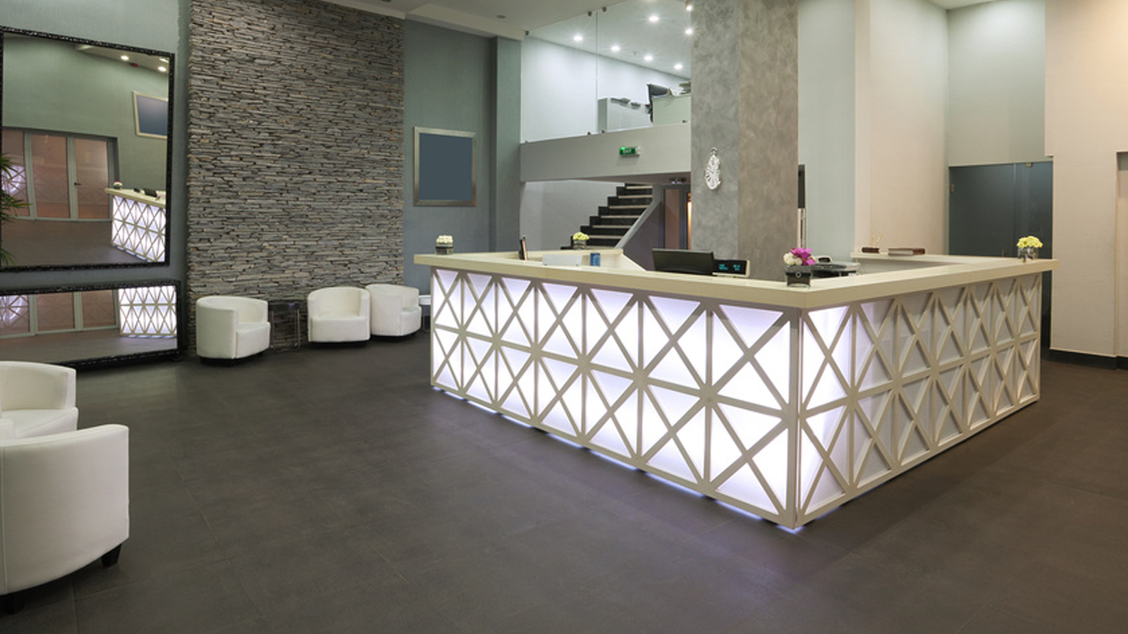
Waiting/reception space

Slide 4

Four Offices

Slide 5
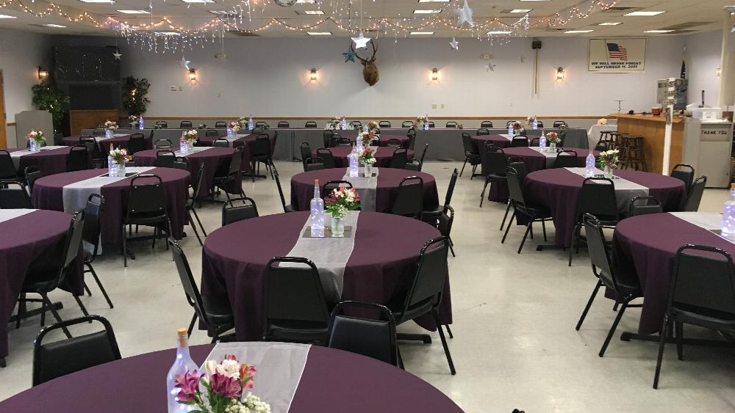
Banquet Hall

Slide 6

Conference Room/Space

Slide 7
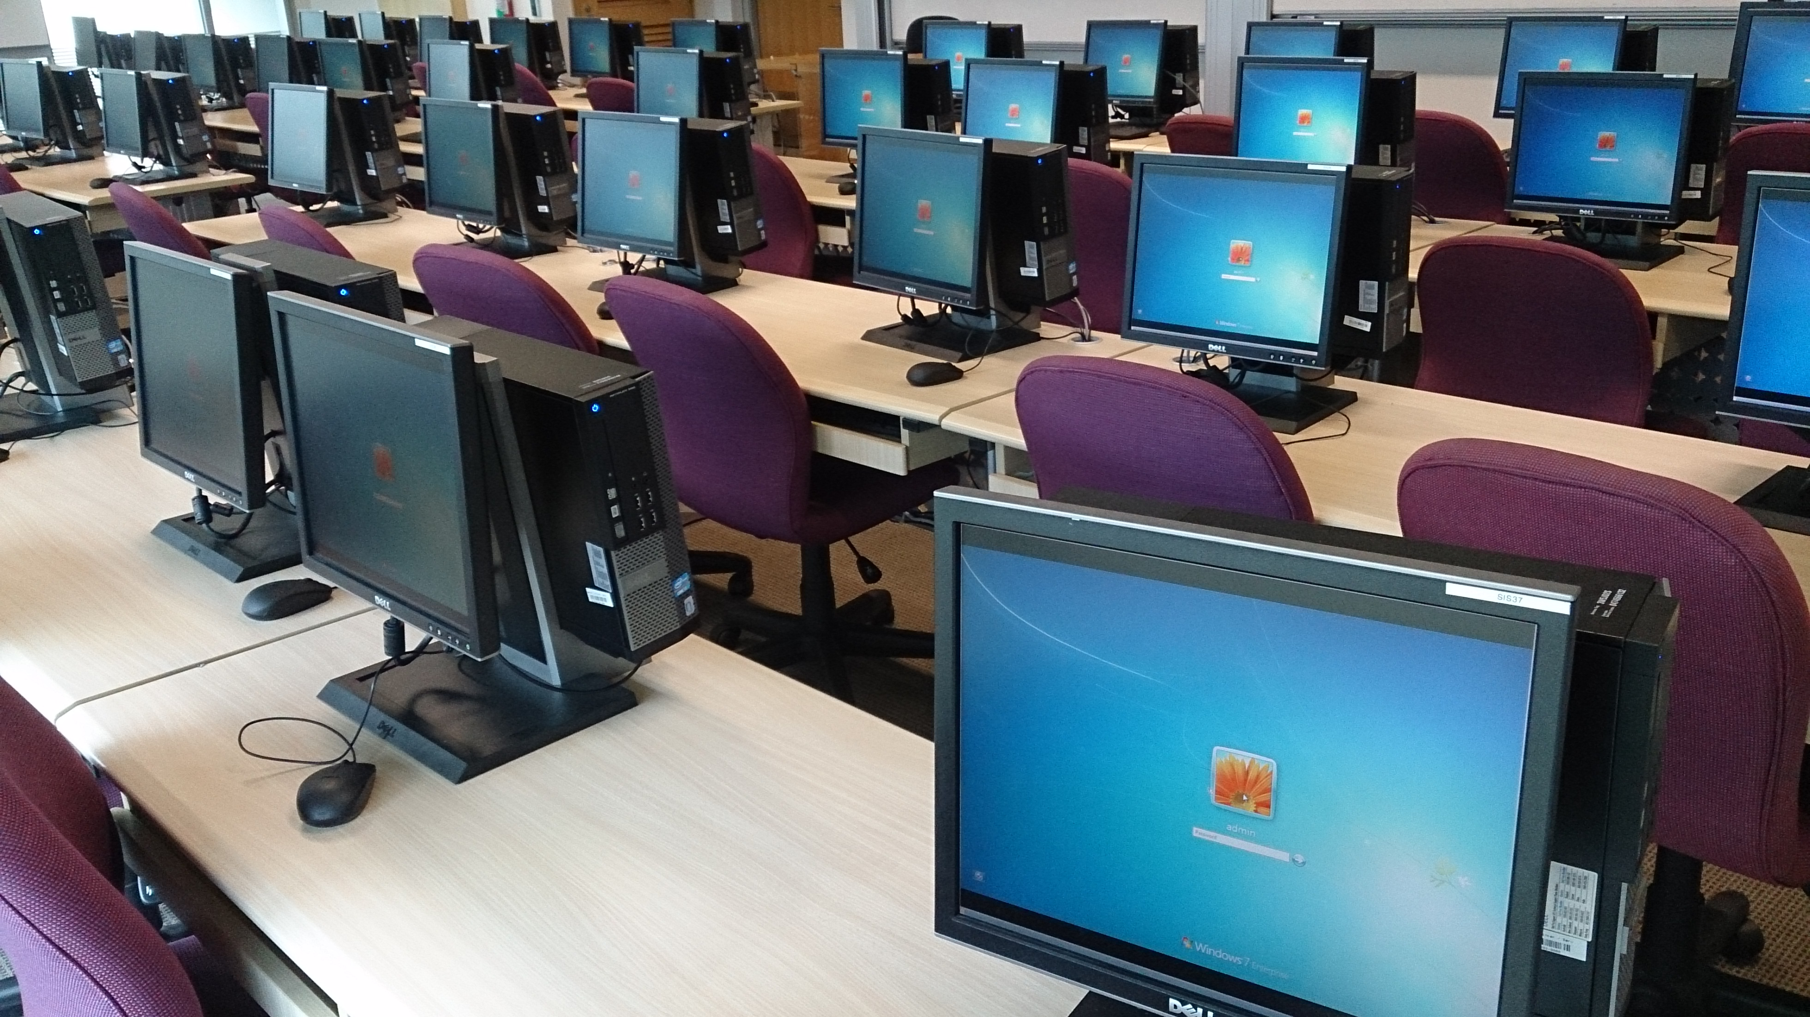
Computer Lap

Slide 8
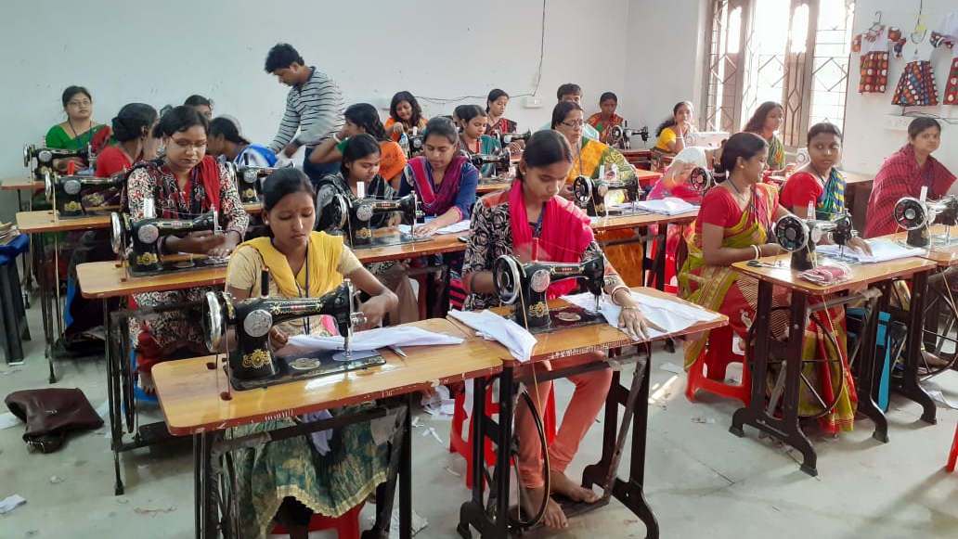
Women Tailoring Training Space

Slide 9

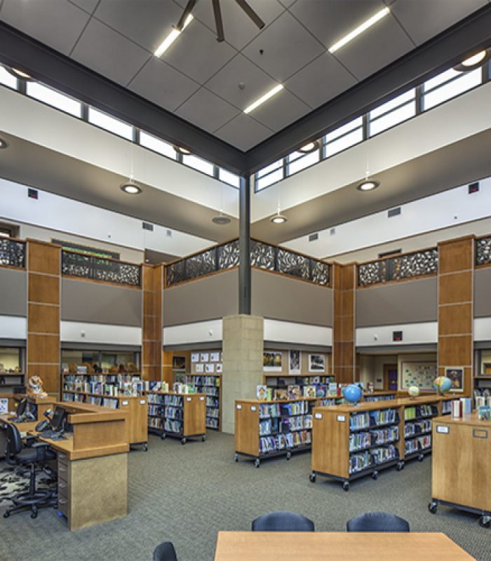
Library Space/Digital and Hard Copy Resources

Slide 10
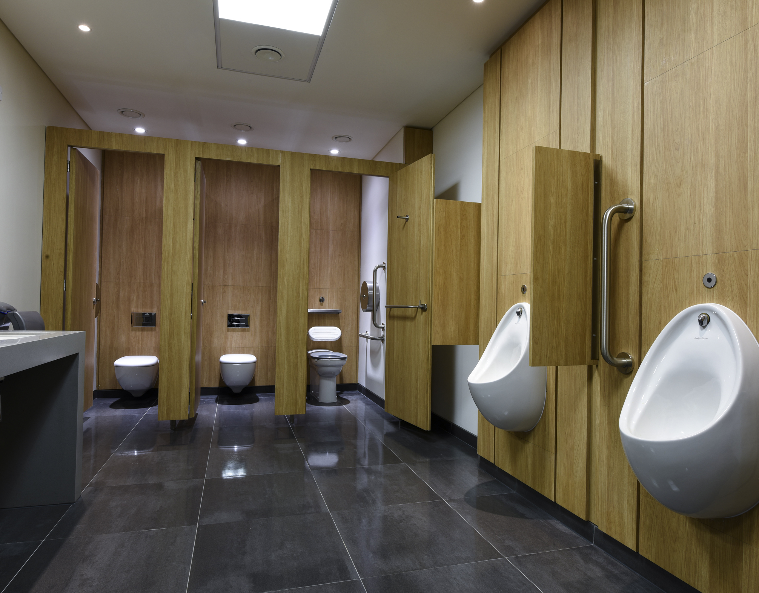
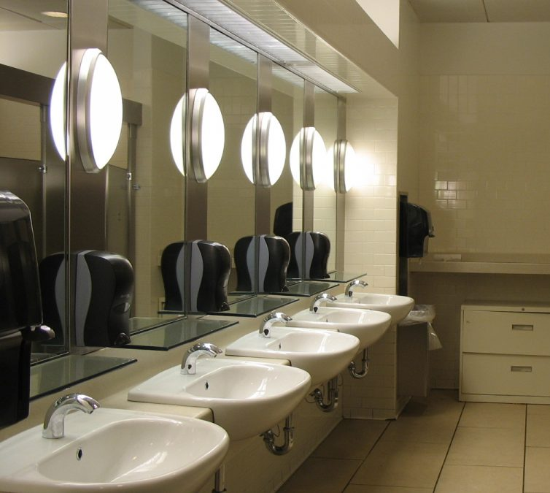
Bathrooms

Slide 11
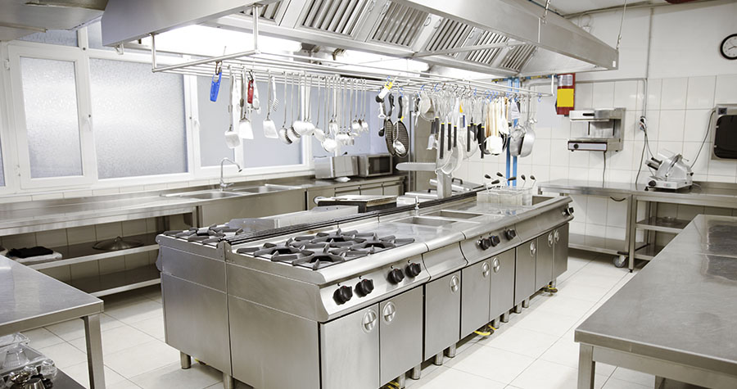
Commercial Style Kitchen

Slide 12
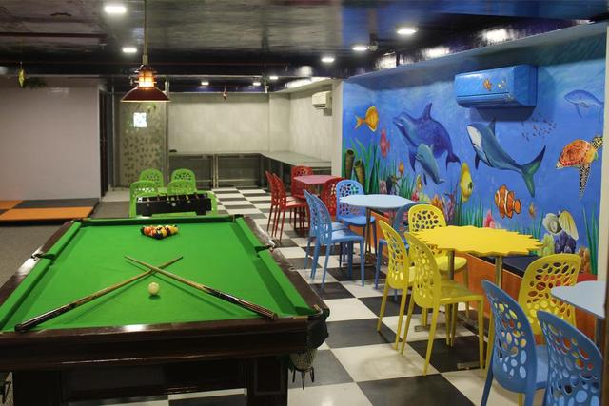
Indoor Recreation Space

Slide 13

Possible Partnerships
Empowerment Square
Liberia Telecommunication Authority
ArcelorMittal Liberia

Slide 14
Propose SEED MONEY
$300,000.00
What is a Seed Money?
A seed money is money allocated to initiate a project

Slide 15
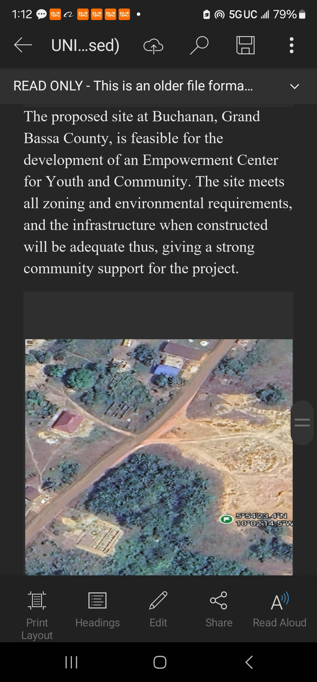

Slide 16
What has happened since last convention when we presented the proposal?
1.1 Acers of land purchased.
Land assessment report
Floor plan
3D future center.

Slide 17
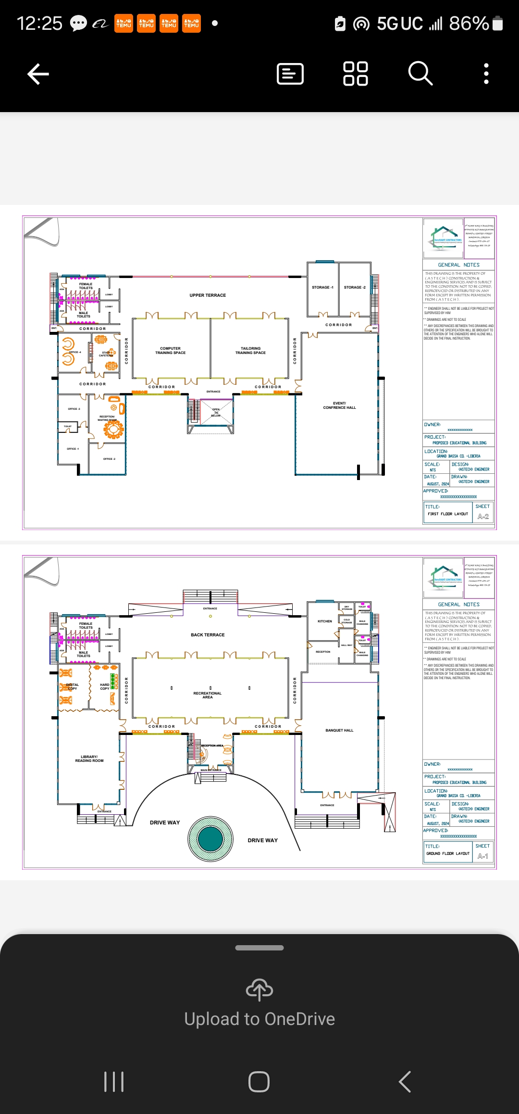
Floor Plan

Slide 18
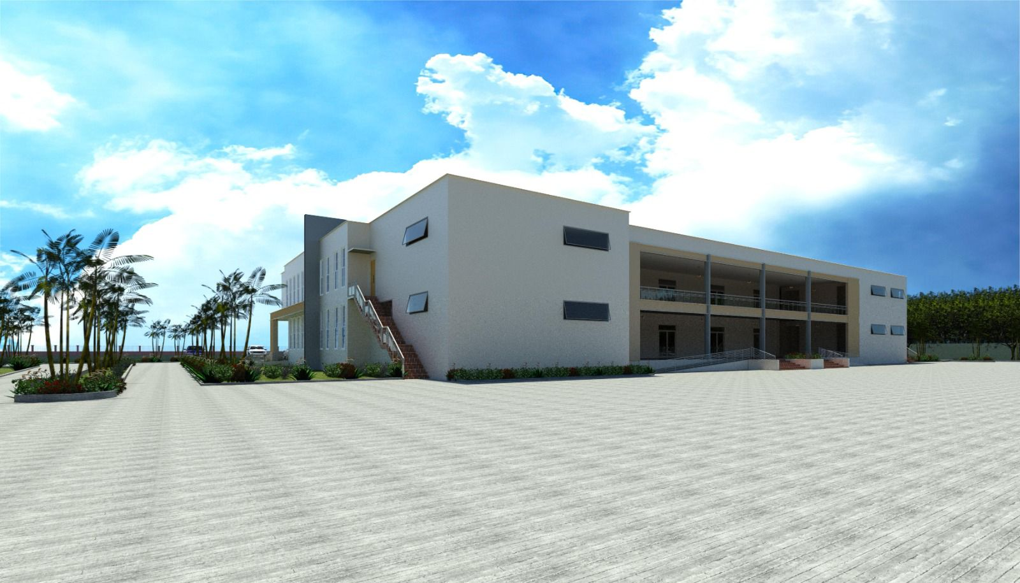

Slide 19
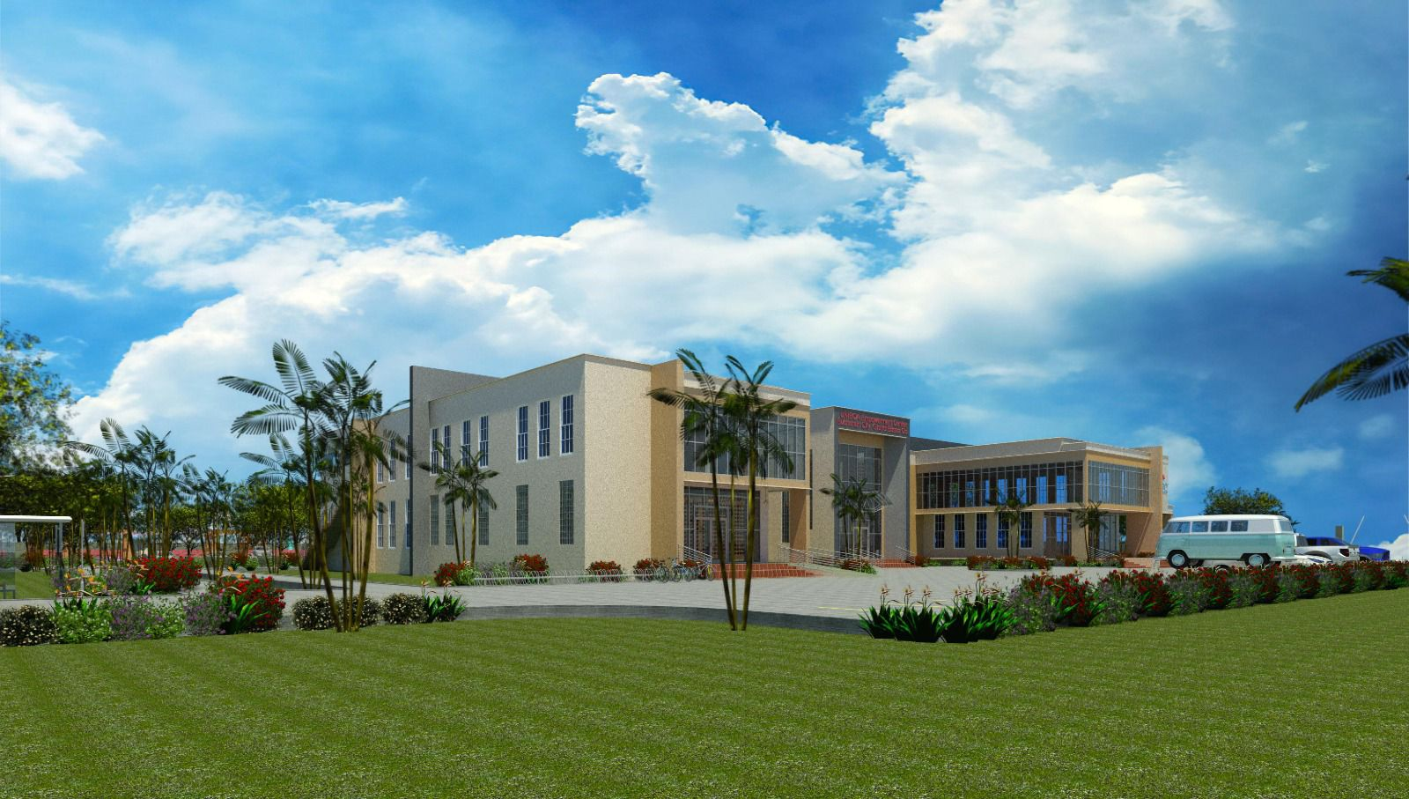
UNIBOA PROPOSED EMPOWERMENT CENTER 3DS IMAGE

Slide 20
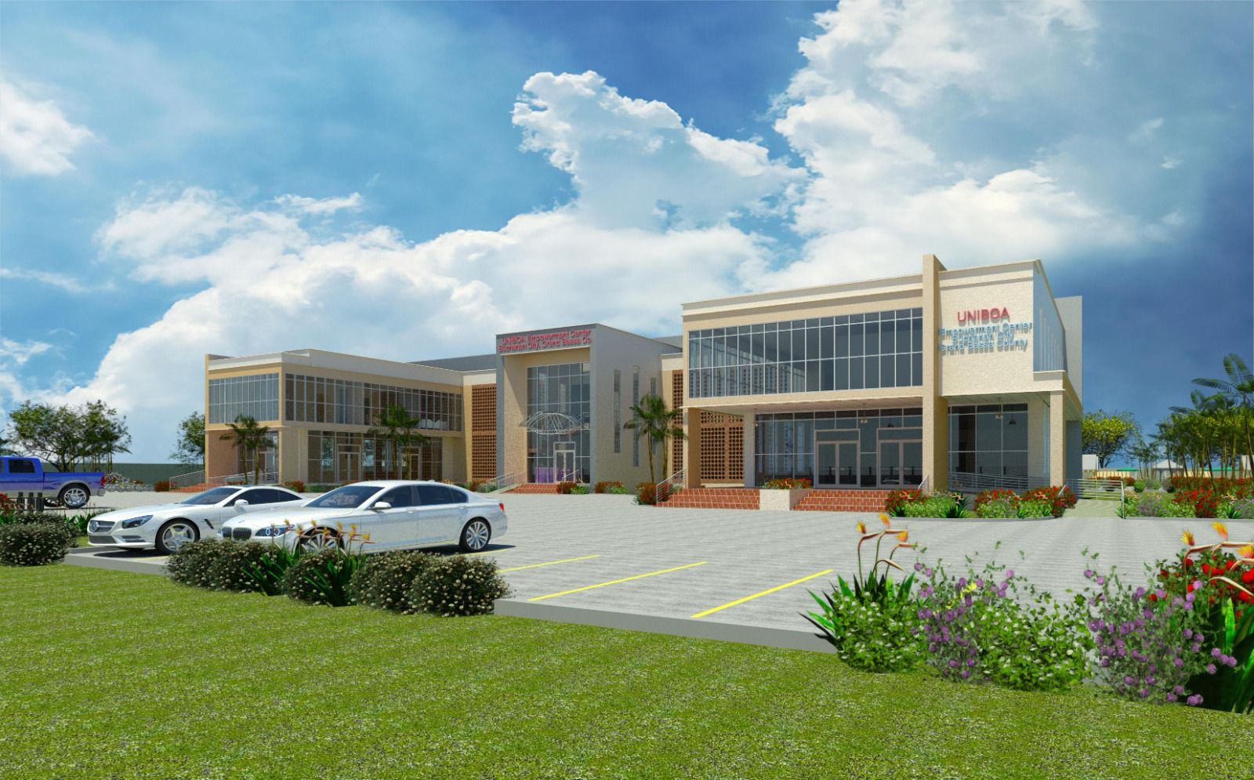
UNIBOA PROPOSED EMPOWERMENT CENTER 3DS IMAGE

Slide 21
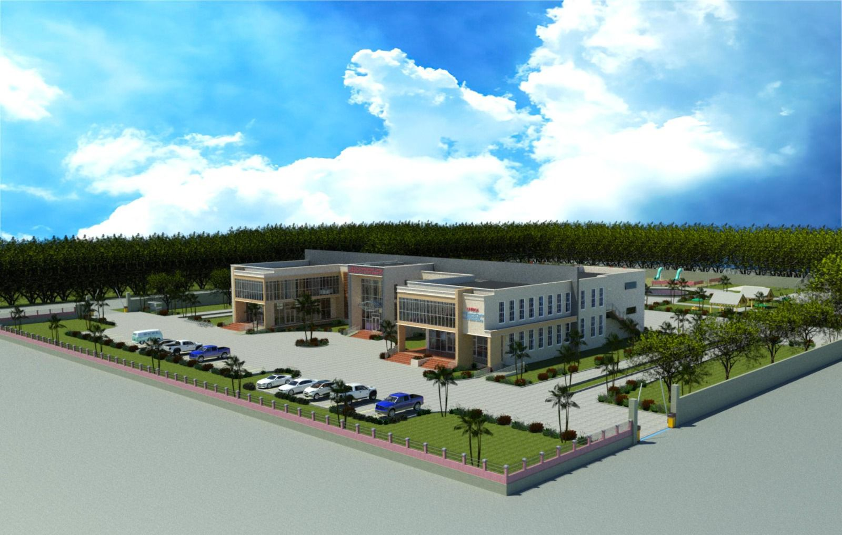
UNIBOA PROPOSED EMPOWERMENT CENTER 3DS IMAGE

Slide 22
Donation toward the project so far
15,000 plus
PLUS 2 ACERS OF Land
You can donate to the project for IRS tax write-out.

